Slide 1
Weather Prediction System
Edge of future and present

Slide 2
Purpose of the project:
Creating a weather prediction website.
> significance of accurate weather predictions.
It warns people about the impending severe weather conditions and other weather hazards such as thunder storms, hurricanes, and heavy rainfalls. Thus far, accurate weather predictions have been able to save the lives of many.
Importance of reliable weather data !!
Weather data is tremendously important to agriculture and infrastructure planning. Various industries use weather data for real-world business cases, such as travel planning, demand forecast, and supply chain management.

Slide 3
Table of contents
01
03
02
04
Front-end & Back-end
API
User interaction and server
handling
Real time data of gov. Satellites .
Database setup
Data anlys.& deploy
Databases for storing historical weather data.
Analysis for better accuracy and deploy on servers online

Slide 4
Whoa!
the savior of all weather related problems

Slide 5
—Someone Famous
“Life isn’t about waiting for the storm to pass — it’s about learning to dance in the rain.”

Slide 6
01
Front- end & back-end
For front-end (html ,css, js) and backend includes python (django) or node.js (express)

Slide 7
02
Database
For database we use mysql or mongodb

Slide 8
03
API
We use gov. Based api of satellites and some open source also for current weather and then some machine learning to enhance it.

Slide 9

Forecasting with API
Know the importance of real-time data updates using weather APIs.With APIs like OpenWeatherMap or Weatherstack or any other can make people on earth lives easy .

Slide 10
Now some stats.

Slide 11
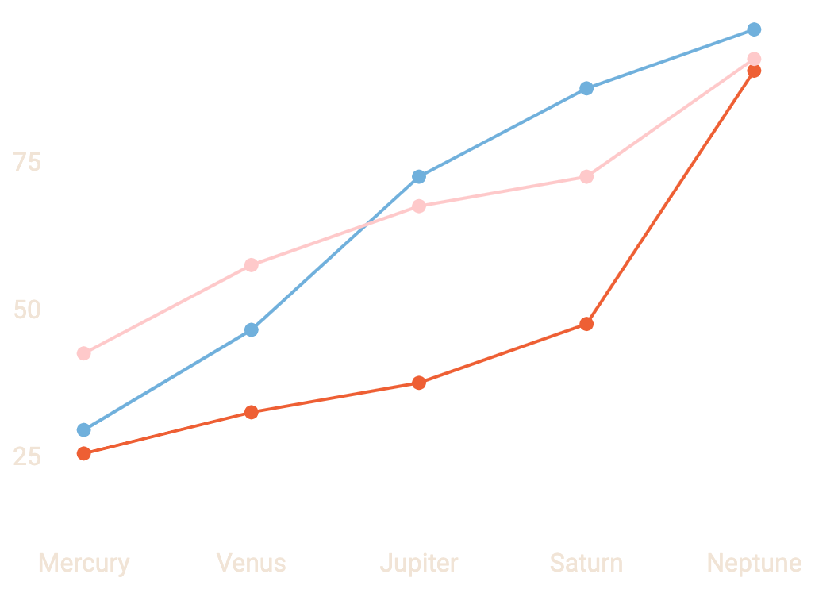
This is a graph
Factor 1
Temp. in that location
Factor 2
Air pressure and wind speed .
Factor 3
Humidity and cloudiness.
Just an example stats. to show case the data relation to our project .

Slide 12
This is an infographic
Today
Rain
Humidity
Wind
Mercury is the closest planet to the Sun and the smallest of them all
5%
31%
64%
6:00
9:00
12:00
15:00
18:00
21:00
24:00

Slide 13
This is a table
Mon | Tue | Wed | Thu | Fri | Sat | Sun
Delhi | Jaipur | Chandigarh | Mumbai | Punjab | Bengaluru | Himachal
63°F | 50°F | 55°F | 67°F | 62°F | 65°F | 42°F
19°C | -1°C | 13°C | 21°C | 16°C | 9°C | 6°C

Slide 14
This is a map
Your city
Mon
Tue
Wed
Thu
Fri
Sat
Sun

Slide 15
This is a timeline
Monday
Wednesday
Friday
Possibility Of Heavy Rainfall
cloudy
Slight windy day
Tuesday
Thursday
Mild sunlight
Tem. will goes up

Slide 16
655,400
Big numbers catch your attention

Slide 17
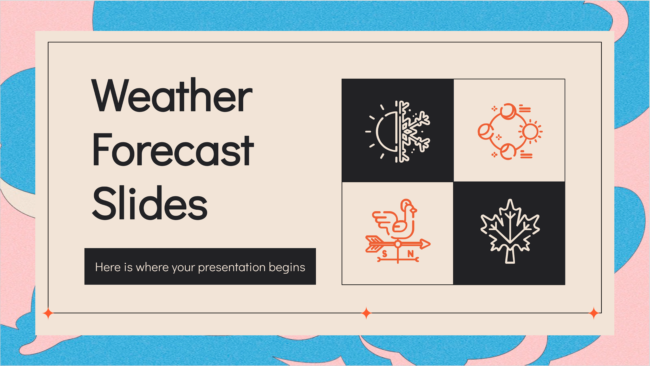
PC View
The normal view will look just like these OR maybe changed if we dont like the UI

Slide 18
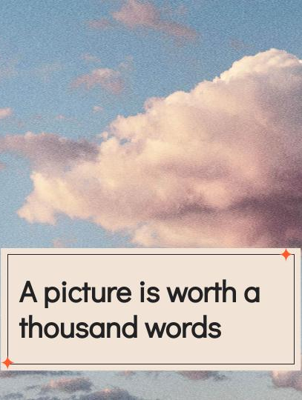
Tablet view
For any tablet or new divides
If developed in future just in
case

Slide 19
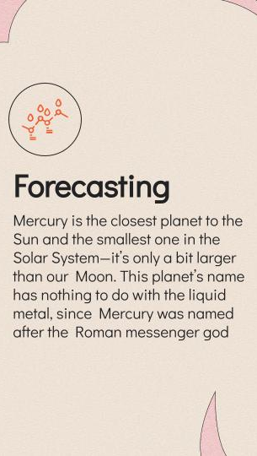
Mobile View
For any *smart phones

Slide 20

Team
Satyam
Sumit
Interested in backend servers and *money only.
Here you could talk a bit about this person and provide a short bio

Slide 21
The weather this week
Mon
Tue
Wed
Thu
Fri
Sat
Sun
12°-27°
6°
12°
24°
17°
21°
18°
2%
0%
3%
4%
5%
9%
1%

Slide 22
Our services
Basic
Pro
Premium
$0.00
$1.09
$5.90
Service 1
Service 2
Service 3
Service 1
Service 2
Service 3
Service 1
Service 2
Service 3

Slide 23
Thank You :

Slide 24
Resources
Did you like the concept ? we will make our website live in few months and we will make it open source so views can also contribute :
Data and technology
Google and books .
Edited and developed by my team
All credits goes to the team
PHOTOS
Google & some websites
ICONS
Weather icon pack

